Slide 1
Upstart ($UPST) Long
Price Target: $83.25, Expected Return: +26.5%
University of California, Berkeley
Ashwin Bindra and Tejas Thvar

Slide 2
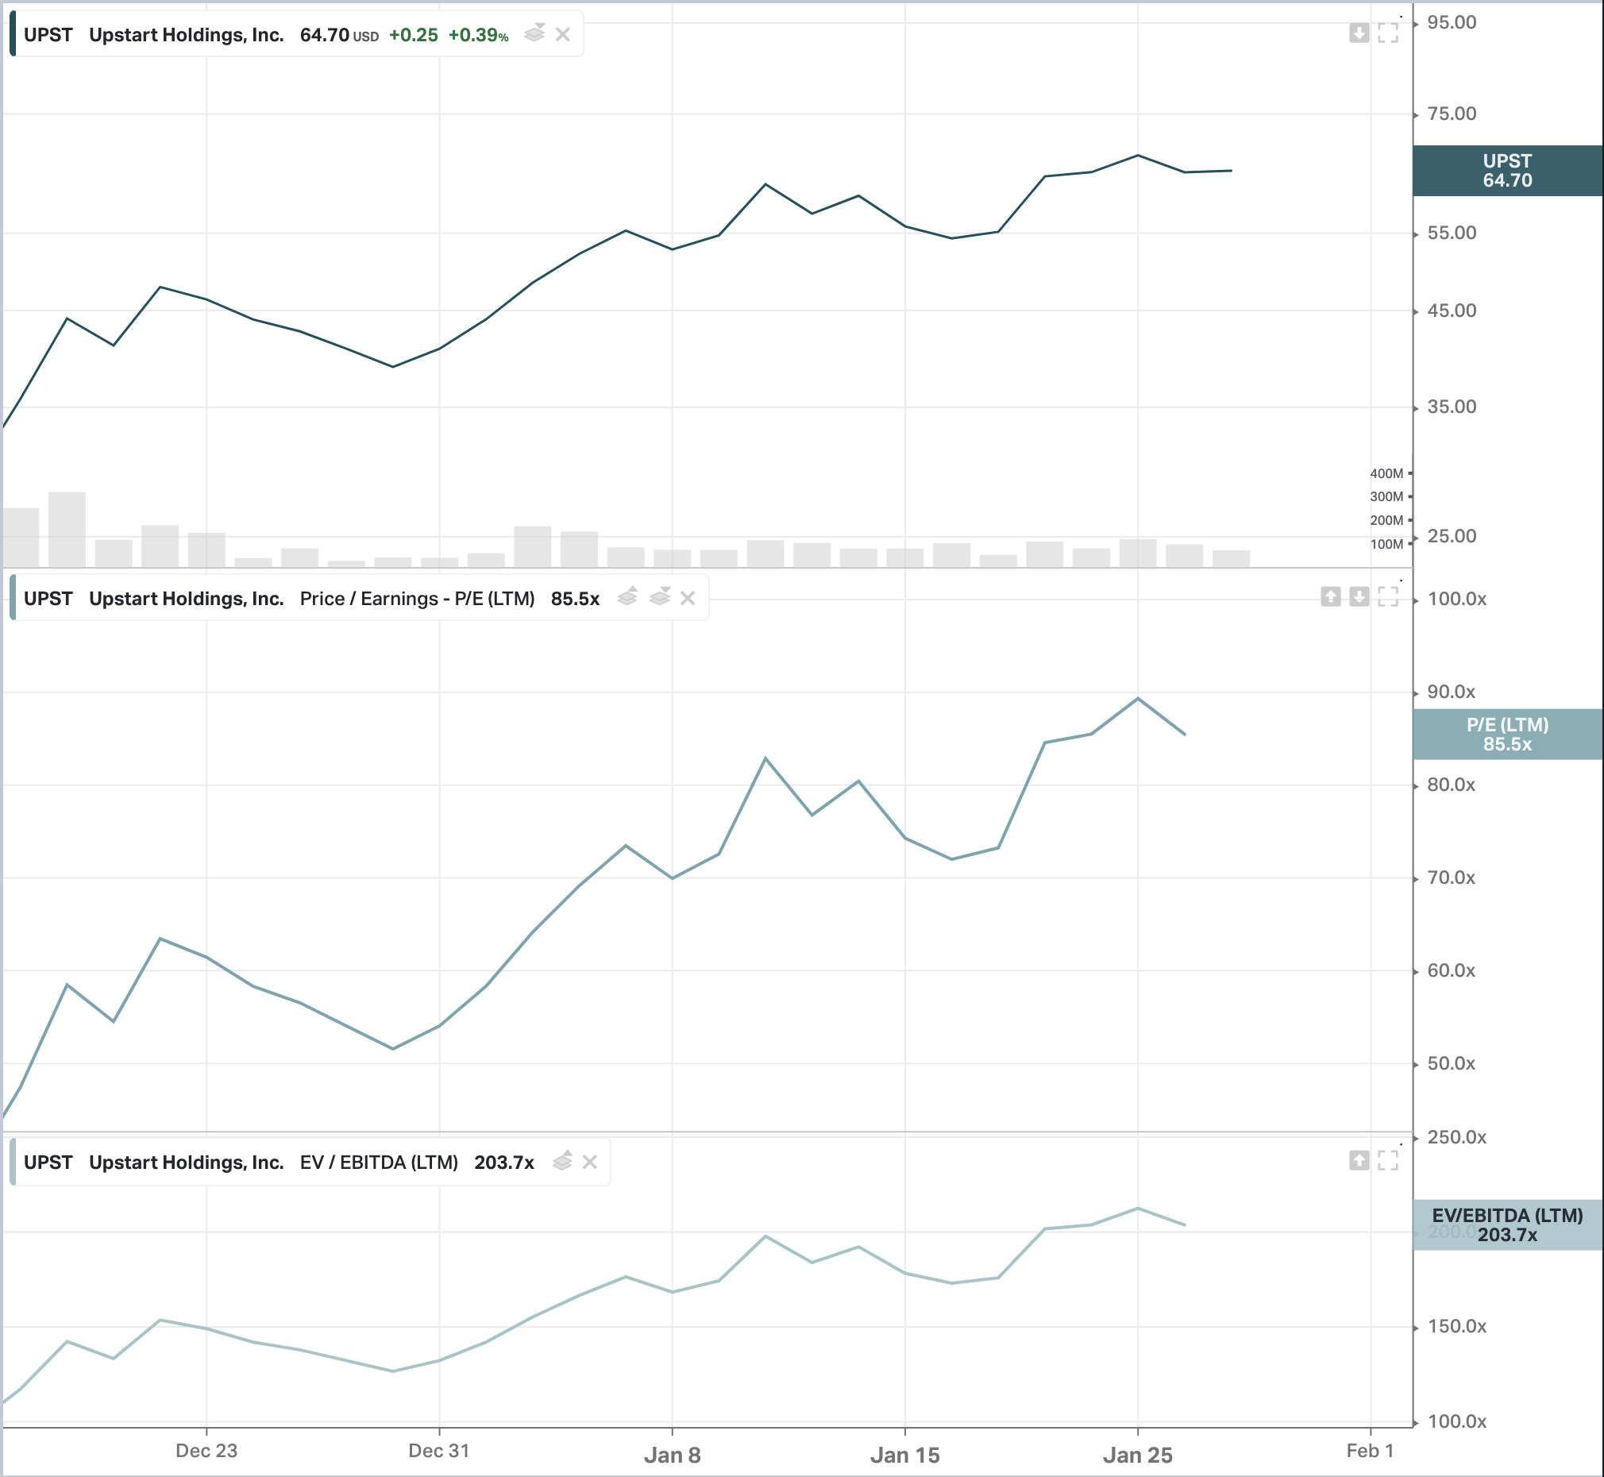







Industry and Business Overview
Upstart’s Business Model and Recent Industry Dynamics
Products: UPST is a loan platform provider and partners with commercial lenders to underwrite loans
UPST’s proprietary statistical machine learning algorithms accurately assesses credit risk, including variables such as credit score, education, field of study, income, potential future earning income, and debt obligations among other factors
Loan Process: 1. Consumer requests loan via Upstart.com or other source
2. UPST underwrites the consumer and assesses his/her credit quality
3. UPST provides the consumer the loan via capital from a partner bank
4. UPST services the loan on the behalf of the partner bank (collects
and sends payments to partner banks subtracting a servicing fee
Key costs include customer acquisition/marketing, R&D expenditure, payroll, and 50% of UPST
loans are through Credit Karma
Financials: $146M Revenue 2020 Q1-3 (+30%) | P/E 425.66 | Market Cap $9.1B
Industry Dynamics: Unsecured Personal Loan Balances at record high of $161B (+17% YOY)
FinTech loans comprise 38% balances (+9% YOY) increased from 5% in 2013 [TransUnion 2018 Q4]
21.1 million unsecured personal loans (+18% YOY) | $8,402 Average Debt per Borrower (+4% YOY) [TransUnion 2018 Q4]
Preference for online loans has increased 30% over past 2 years
Key Competitors:
Overview
Theses
Valuation
Pre-Mortem

Slide 3
Investment Overview – Short $FIVE
FIVE has fundamental flaws in its business that will lead to growth deceleration
Theses
FIVE relies too heavily on neighboring stores to drive foot traffic to FIVE locations.
FIVE has no leverage and increasingly relies on store growth to maintain guidance.
FIVE relies on ”trends” to drive growth.
Pre-Mortem
Valuation
Betting Against a Growing Company
FIVE Increases Operating Leverage
We are expecting a decline in FIVE share price to $87.88, with an expected probability-weighted return of -22.4%
Expert and Experienced Management Team
Overview
Theses
Valuation
Pre-Mortem

Slide 4
Investment Timeline– Short $FIVE
FIVE has fundamental flaws in its business that will lead to growth deceleration
Mgmt expected to adjust 20/20 plan or earnings miss
Q2 2020 Results
July 2020
Annual ICR Conference
January 2021
Short-Term
Fiscal Year 2019 Results
March 25th, 2020
Q1 2020 Results
April 2020
Q3 2020 Results
July 2020
Long-Term
Decline in foot traffic as a result of nearby stores push to e-commerce
Instore retail continues to suffer as industry-wide push towards e-commerce
Overview
Theses
Valuation
Pre-Mortem

Slide 5
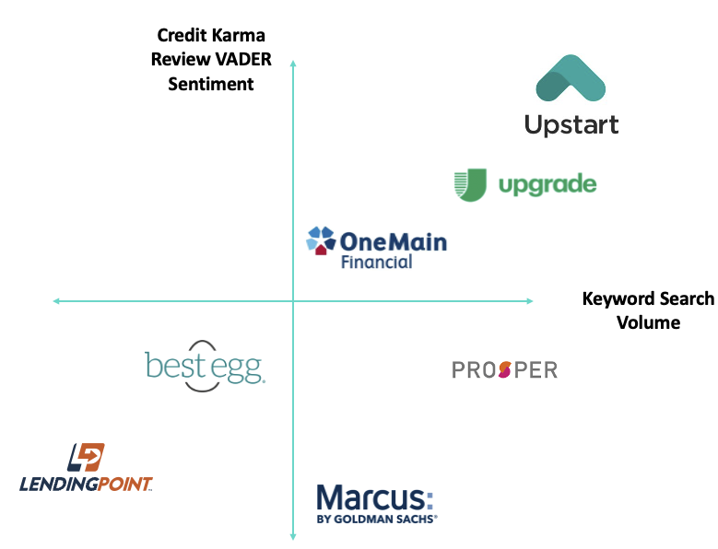
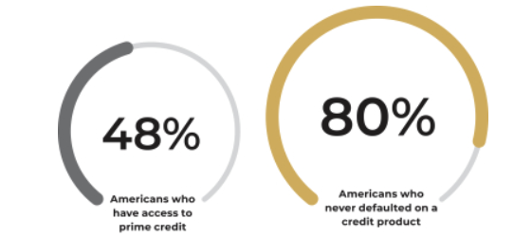
Best-In-Class Underwriting
Utilizing proprietary ML/AI algorithms and more robust data ingestion, Upstart can more accurately underwrite consumers
Superior Underwriting Ability:
Underwriting, especially for the smallest banks and credit unions, has not kept up with the pace of innovation in cloud computing and ML. The average small/mid-sized banks still rely on static FICO scores.
In the US alone, 80% of Americans never defaulted on a loan payment yet only 48% of Americans have access to prime credit.
UPST’s AI/ML algorithms capitalize on over 1,600 variables and have been trained on > 9,000,000 repayment events
Banks that partner with UPST can take on more loans for the same level of risk. UPST underwriting allows for 27% more borrowers than traditional models at 16% lower avg APRs.
UPST’s model approves almost double the number of consumers with FICO scores ranging from 620-660
UPST has seen is model continually improve over time. As seen on the right, UPST has seen its fully automated loans increase 32% from 34% to 66% of transacted loans in just two years.
This represents an underwriting flywheel that allows efficiency to compound over time (more on this in thesis #2).
UPST holds a ‘no-action’ letter from the CFPB. The CFPB selectively gives out no-action letters for companies pursuing technologies that can have outstanding benefits for consumers. Given the historic conservatism of the CFPB, it is hard to understate the vote of confidence the CFPB was willing to give the young start-up.
Overview
Theses
Valuation
Pre-Mortem

Slide 6
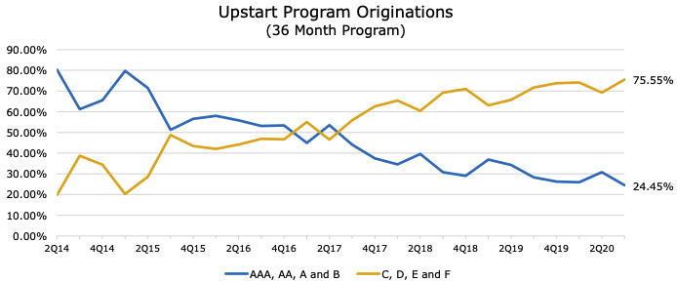
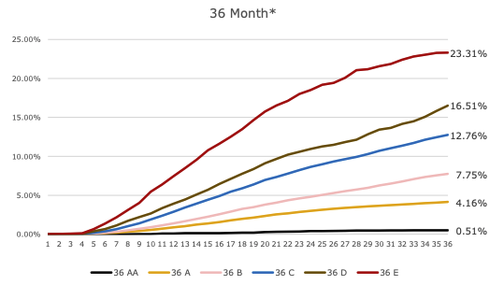
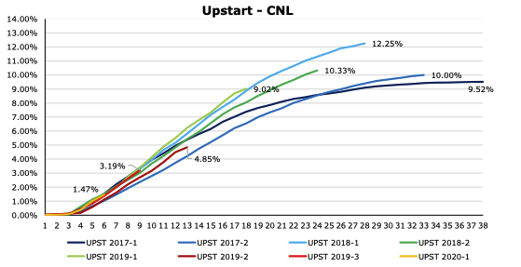
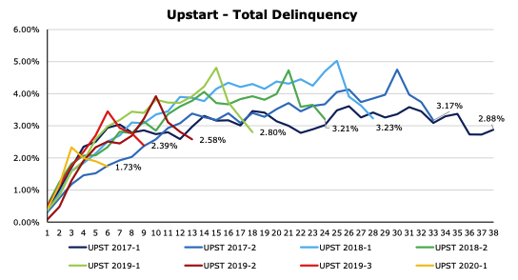
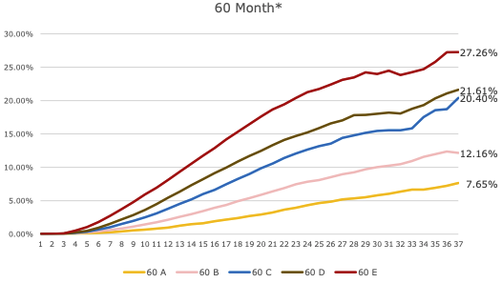
Best-In-Class Underwriting (cont.)
Analyzing securitizations of Upstart loans provides a lens into the efficiency of Upstart’s underwriting abilities
Securitized Loans Analysis:
UPST’s superior underwriting capabilities allow it to approve “riskier” loans with little effect on delinquencies and cumulative net loses (“CNL”).
UPST has become more confident in its model’s underwriting ability. As of July 2020, 76% of loans originated from UPST were rated C, D, E, or F by Moody's, up from 20% in 2014. Despite originating lower grade loans, UPST has seen no impact on its delinquency rates or CNL. This is indicative of UPST’s ability to underwrite risk more accurately than traditional underwriting models.
Furthermore, despite riskier loans, Upstart has seen is CNL remain constant or decrease over time as their model improves.
As compared to Moody’s loss predictions, actual realized losses were 31% to 71% lower. On average, Upstart saw a deviation of -48% when compared to Moody’s loss predictions.
With best-in-class technology, UPST proves its superior underwriting ability. Over time we hypothesize that more and more banks will be willing to fund Upstart written loans with a continued track record of success.
Currently ~93% of revenues come from UPST referrals. We think this will decrease to 74% by 2023.
Even in times of economic downturn, UPST’s relatively nascent model was able to be more accurate than current lending practices. During the COVID-19 pandemic, UPST’s model was able to be 5x more predictive than FICO scores.
More illustrative, bank partners were quick to “turn-on” UPST during COVID. Q2 2020 saw an 86% q/q decline in loan originations as bank partners and capital markets aggressively sought to reduce risk. In Q3 2020, however, loans originated recovered rapidly to 96% of pre-COVID levels. This represented a strong vote of confidence by UPST’s funding sources.
Overview
Theses
Valuation
Pre-Mortem

Slide 7
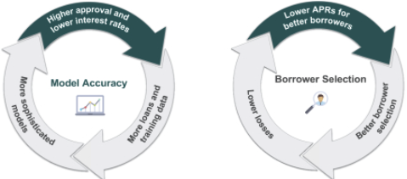
AI Flywheel
Upstart has a flywheel which drives continuous improvement as it scales
UPST’s flywheels serve to increase model accuracy and borrower selection as it scales.
More loans and trading data allow for a more sophisticated model → leading to higher approval → lower interest rates.
Lower APRs for borrowers → better borrower selection → lower losses for UPST.
Their flywheel dynamics are directly trigged by increase the number of loans transacted. UPST has seen its loan funnel conversion increase from 8.1% in 2017 to 13% in 2017.
VADER Sentiment Analysis
Credit Karma currently accounts for ~50% of traffic to UPST
Using Credit Karma reviews as a proxy for customer sentiment, our team analyzed over 2,000 credit karma reviews on UPST and its main competitors.
Valence Aware Dictionary for Sentiment Reasoning (VADER) is a model used for text sentiment analysis that is sensitive to both polarity (positive/negative) and intensity (strength) of emotion
UPST consistently ranked high in its VADER1 sentiment analysis score and keyword search volume. UPST scored 3.0x average positive sentiment.
UPST generates 2.7x avg monthly search volumes and demonstrates strong organic CTR rates.
With a focus on growing conversion rates and increases loans transacted, UPST can keep its flywheel spinning and ensure its model continues to improve over time.
Overview
Theses
Valuation
Pre-Mortem

Slide 8
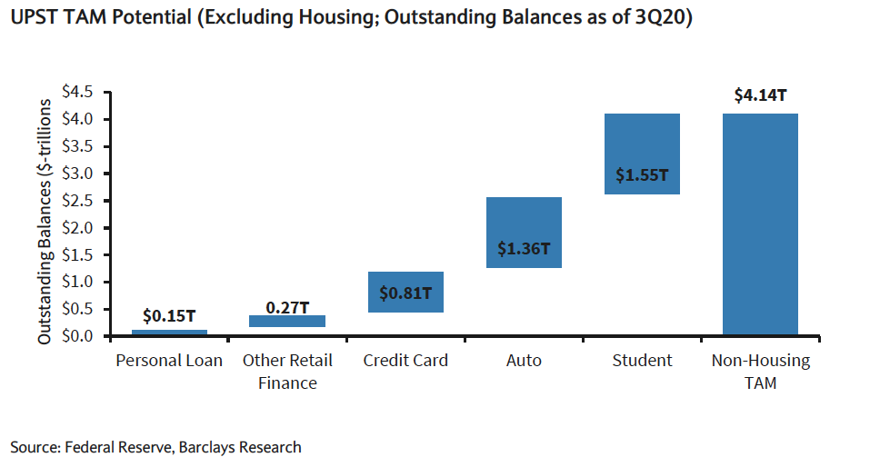
Upstart is playing into a large, rapidly expanding TAM
Upstart’s total addressable market continues to increase and maintain low pentation
Underpenetrated, expanding loans market:
UPST currently focuses on unsecured loans, which represents a TAM of $118 B
With superior underwriting, UPST has been able to begin to move into other loan markets such as auto loans ($625 B), equity lines, credit card refinancing, student loans, and POS financing
All combined, the TAM for UPST is > $900 B
Adoption of FinTechs and banking Alternatives
UPST benefits from the secular trend of consumers moving away from tradition lenders after the GFC.
Personal Loans for FinTechs grew at 85% CAGR from 2013-18
The Great Financial Crisis of 2008 created a perfect environment for the rise of FinTechs like UPST. Greater capital requirements for traditional lenders and increased regulation formed a perfect storm for FinTechs:
Banks had stricter underwriting standards, which limited access to affordable credit for consumers
FinTechs have also been able to use stronger customer acquisition models
COVID-19 may prove to help accelerate UPST’s adoption. Consumers have become more comfortable with online services (e-commerce, FinTechs, neo banks). Post vaccine deployment, these consumers may seek to take more loans.
Searches for loans during COVID-19 yielded the results on the right, notably student and personal loans ranked in the top three results.
Overview
Theses
Valuation
Pre-Mortem

Slide 9
Valuation
Using a Discounted Cash Flow Model the future value of FIVE was determined
Key Financials
USD Millions
Years | 2017 | 2018 | 2019E | 2025E
Store Count:
Beginning Stores | 522 | 625 | 750 | 1777
Net New Stores | 103 | 125 | 150 | 222
Ending Stores | 625 | 750 | 900 | 2000
Growth | 19.7% | 20.0% | 20.0% | 12.5%
Comparable sales growth | 6.5% | 3.9% | 2.3% | 1.4%
Net sales | 1278 | 1560 | 1877 | 5005
Growth | 27.8% | 22.0% | 20.4% | 13.9%
Gross margins | 36.3% | 36.2% | 36.0% | 35.7%
Operating profit margins | 12.3% | 12.0% | 11.2% | 14.5%
Net profit margins | 8.0% | 9.6% | 9.3% | 11.7%
Net income | 103 | 150 | 175 | 587
Growth | 42.8% | 46.0% | 16.7% | 15.8%
Valuation
 | Downside | Base | Upside
Sum of Present of Free Cash Flow | 950 | 1028 | 1159
2025E EBIT | 639 | 727 | 888
Exit EV/EBIT | 2.5 | 5 | 7.5
Terminal Value | 1597 | 3635 | 6657
Enterprise Value | 2548 | 4664 | 7816
Subtract Net Debt | 0 | 0 | 0
Equity Value | 2548 | 4664 | 7816
Shares Outstanding | 56.0 | 56.0 | 56.0
Price Target | 45.48 | 83.25 | 139.53
Current Price | 113.22 | 113.22 | 113.22
Expected Return | -59.8% | -26.5% | 23.2%
Probability | 25% | 50% | 25%
Proabability - Weighted Price Target |  | $ 87.88
Probability - Weighted Expected Return |  | -22.4%
Overview
Theses
Valuation
Pre-Mortem

Slide 10
Pre-Mortem: This investment failed, Why?
Betting Against a Growing Company
FIVE is valued as a growth company, therefore it can continue to open new stores to drive revenue without taking a hit in investor expectations.
Mitigant: FIVE has passed its growth stage. It can no longer sustain high levels of store growth and expect similar financial performance.
FIVE Increases Operating Leverage
FIVE will be able to create more efficient stores and increase operating income, driving revenue growth.
Mitigant: Mgmt is driving growth by increasing store growth, not increasing operational efficiency. Mgmt focuses on store-base growth with no stated plan on decreasing operational expenses.
Expert and Experienced Management Team
FIVE’s strong leadership has proven itself to be leaders in the dollar store industry
”Bad business meets good management team, bad business wins every time.”
-Charlie Munger
Overview
Theses
Valuation
Pre-Mortem

Slide 11
Exhibit A: Code
Code written with Python 3.7 using Google Map Places and Geocode API.
Overview
Theses
Valuation
Pre-Mortem

